Slide 1
Title: WEIGHTS IN MULTIPLES OF 100 GRAMS
Need calculators.
Aim:
Calculate and compare best buys using multiples of 100 grams
Plan:
Daily review
  Integers
Probability
Best buys

Slide 2
Automaticity
Complete in exercise books.
13
18
8
16
12
22
23
9
6
-2
4 + 9 =
10 + 8 =
12 – 4 =
9 + 7 =
7 + 5 =
14 + 8 =
12 + 11 =
18 – 9 =
22 – 16 =
10 – 12 =
-3
-5
33
-8
-10
-9 + 6 =
10 – 15 =
17 + 16 =
32 – 40 =
81 – 91 =

Slide 3
Adding a negative is the same as subtraction
Subtracting a negative is the same as addition

Slide 4
Adding a negative is the same as subtraction
Subtracting a negative is the same as addition

Slide 5
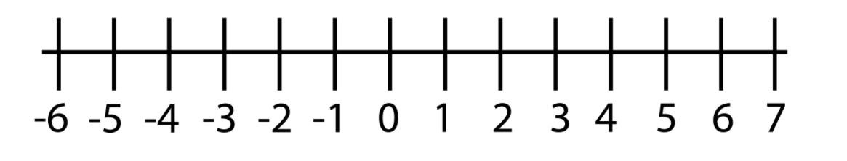
2 – (-4)
= 2 + 4
= 6
5 + (-4)
= 5 – 4
= 1
-5 – (-4)
= -5 + 4
= -1
-5 + (-4)
= -5 – 4
= -9

Slide 6
Write the question without the double signs.
4 – (-4)
=
=
9 + (-4)
=
=
-4 – (-4)
=
=
-7 + (-4)
=
=

Slide 7
WHITEBOARDS
Write the question without the double signs and solve.
10 – (-6)
=
=
8 + (-2)
=
=
-9 – (-5)
=
=
-9 + (-5)
=
=

Slide 8
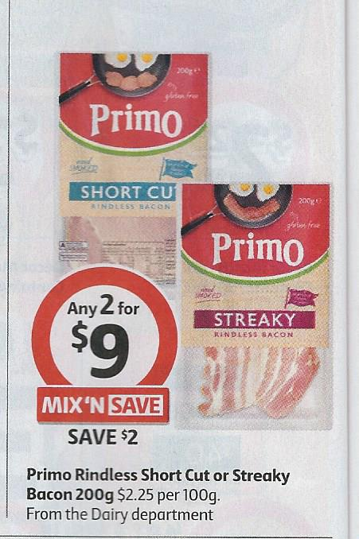
WEIGHTS IN MULTIPLES OF 100 GRAMS
These items are in multiples of 100 g or 100 ml eg: 300 g
Find the cost for 100 grams or 100 ml eg: 300 g ÷ 3
Now find the cost for 1 kg or 1 L (x 10)
Page 2
Page 2 worksheet required

Slide 9
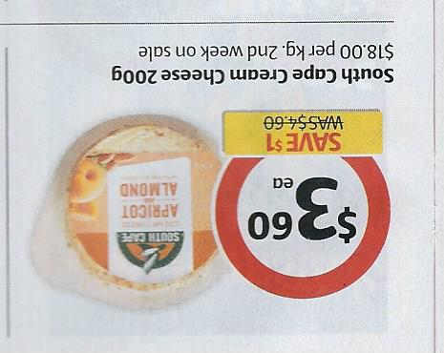
WEIGHTS IN MULTIPLES OF 100 GRAMS
South Cape cream cheese
Find the cost of 100 grams of the item
  200 g costs $3.60
  so 100 g costs $ .......... ($3.60 ÷ 2)
Now find the cost of one kilogram
  100 g costs $1.80
  so 1 kg costs $ ……. ($1.80 x 10)

Slide 10
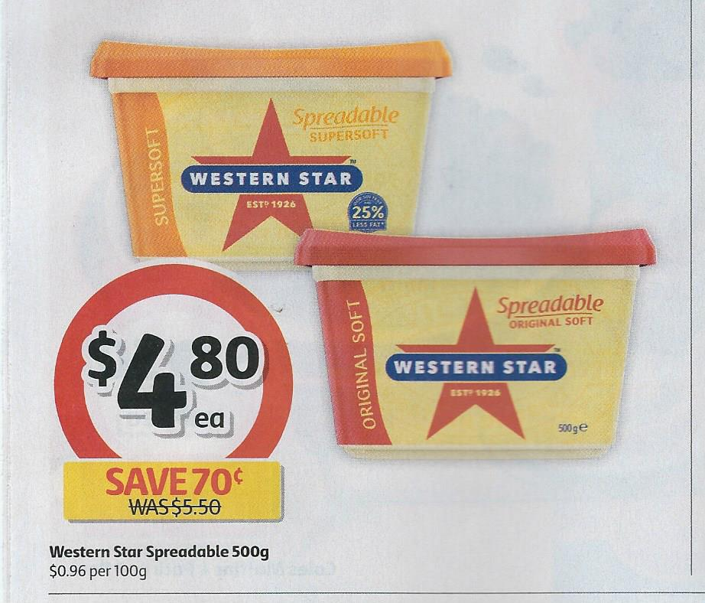
WEIGHTS IN MULTIPLES OF 100 GRAMS
Western Star spreadable butter
Find the cost of 100 grams of the item
  500 g costs $4.80
  so 100 g costs $ .......... ($4.80 ÷ 5)
Now find the cost of one kilogram
  100 g costs $0.96
  so 1 kg costs $ ……. ($0.96 x 10)
What is an easier method to get the one kilogram price when you have the cost of 500 g?
You just …………………………………………………..
Now do Page 2 and Page 3

Slide 11
WEIGHTS IN MULTIPLES OF 100 GRAMS
South Cape cream cheese
Find the cost of 100 grams of the item
  200 g costs $3.60
  so 100 g costs $ ..........
Now find the cost of one kilogram
  100 g costs $1.80
  so 1 kg costs $ …….

Slide 12
WEIGHTS IN MULTIPLES OF 100 GRAMS
Western Star spreadable butter
Find the cost of 100 grams of the item
  500 g costs $4.80
  so 100 g costs $ ..........
Now find the cost of one kilogram
  100 g costs $0.96
  so 1 kg costs $ …….
What is an easier method to get the one kilogram price when you have the cost of 500 g?
You just …………………………………………………..
Now do Page 2 and Page 3

